Slide 1
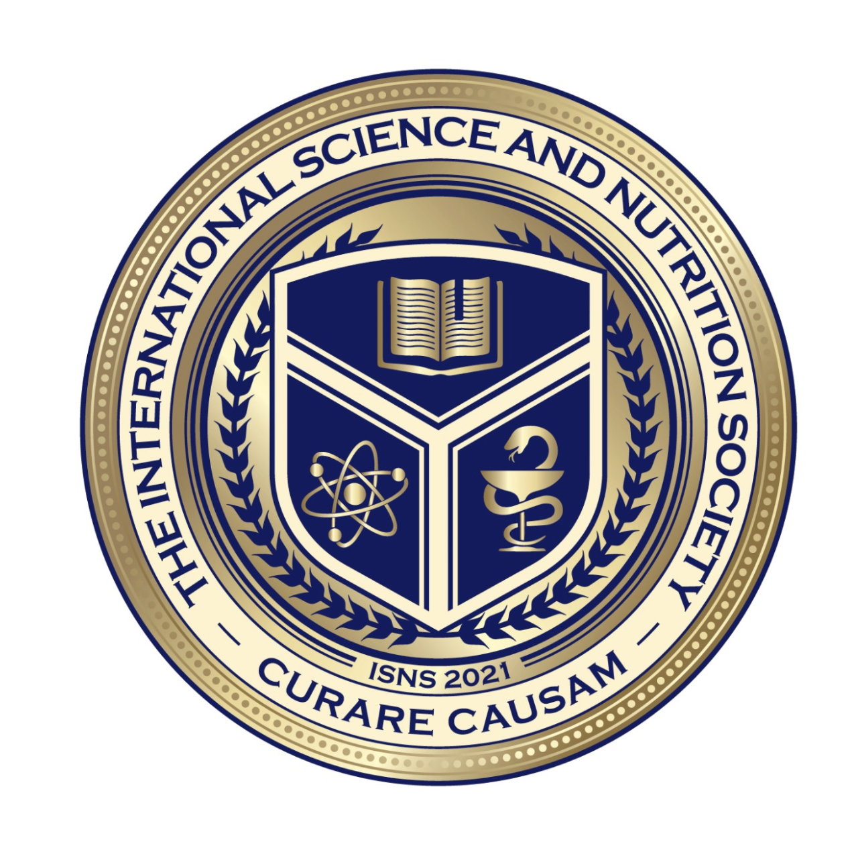
Science with Dr. Christina Rahm We will get started shortly.

Slide 2
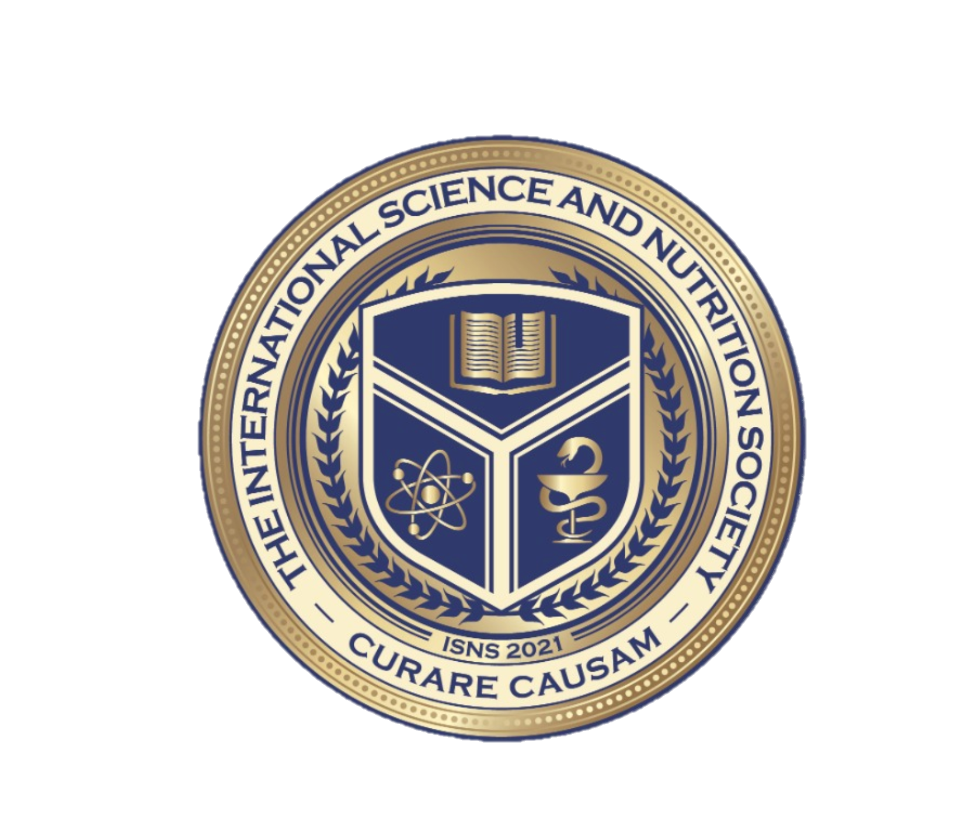
Dr. Dori Naerbo, Ph.D.
Notes:
Good morning, good afternoon, good evening…wherever you are in the world this is Dr. Dori Naerbo and I am your host on today’s call. For those of you who do not know me…I am a clinical researcher and author of several books.

Slide 3
Dr. Christina Rahm CEO & Chief Science Officer

Slide 5
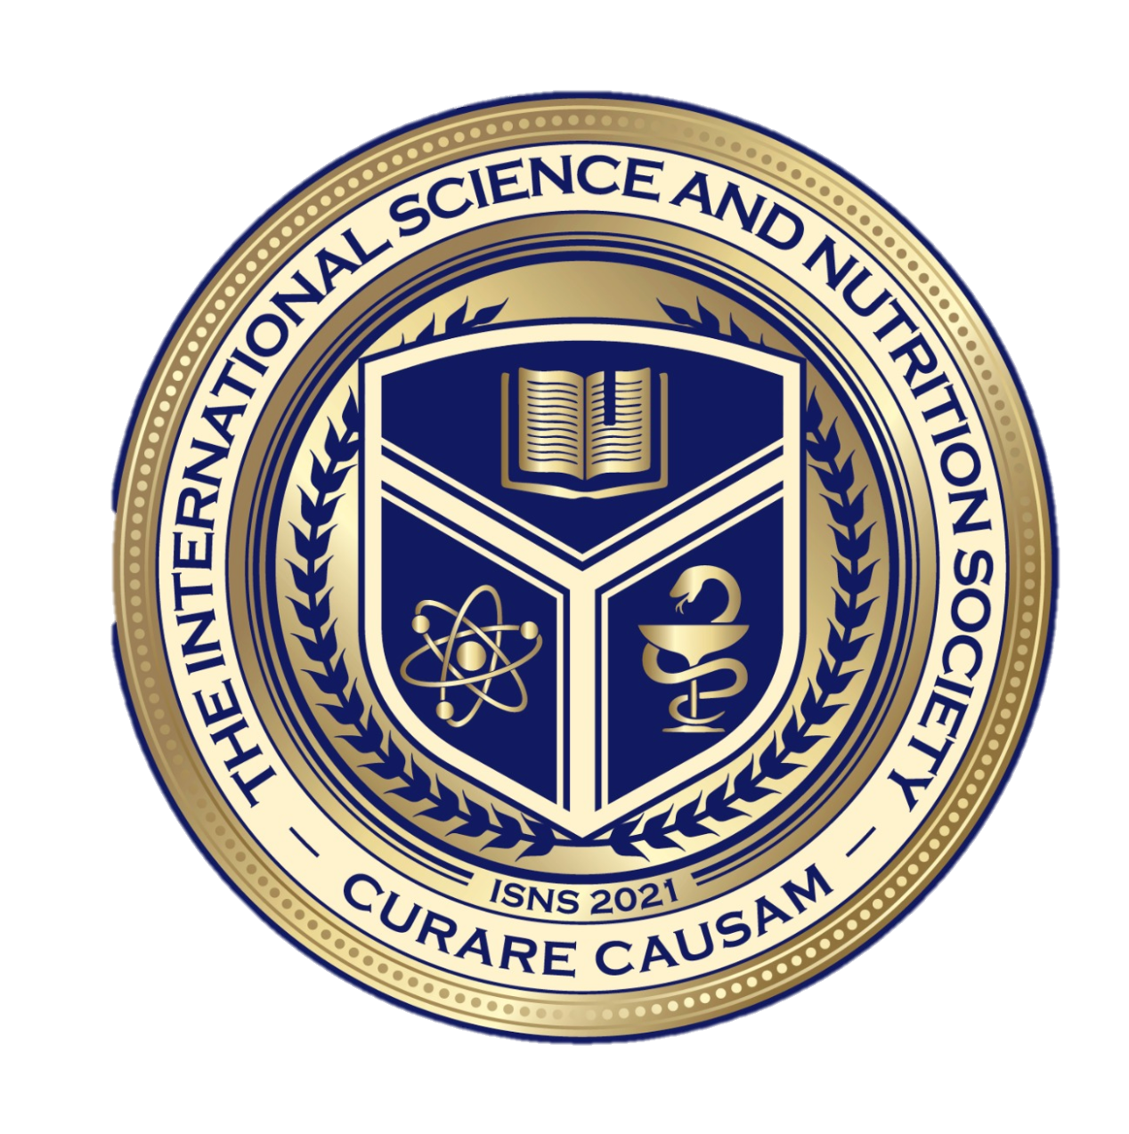
Medical Disclaimer:
The information provided is for educational purposes and is not intended as medical advice, or a substitute for the medical advice of a physician or other qualified health care professional. This is for science and educational purposes only and cannot be used in any aspect for sales or marketing. You should not use this information for diagnosing a health or fitness problem or disease. You should always consult with a doctor or other health care professional for medical advice or information about diagnosis and treatment. This is Confidential. Do not distribute—for scientific educational purposes only.
Notes:
The information provided is for educational purposes and is not intended as medical advice, or a substitute for the medical advice of a physician or other qualified health care professional. This is for science and educational purposes only and cannot be used in any aspect for sales or marketing. You should not use this information for diagnosing a health or fitness problem or disease. You should always consult with a doctor or other health care professional for medical advice or information about diagnosis and treatment. This is Confidential. Do not distribute—for scientific educational purposes only.

Slide 6
ISNS Case Study Presented by: Dr. Norbert Ketskés

Slide 7
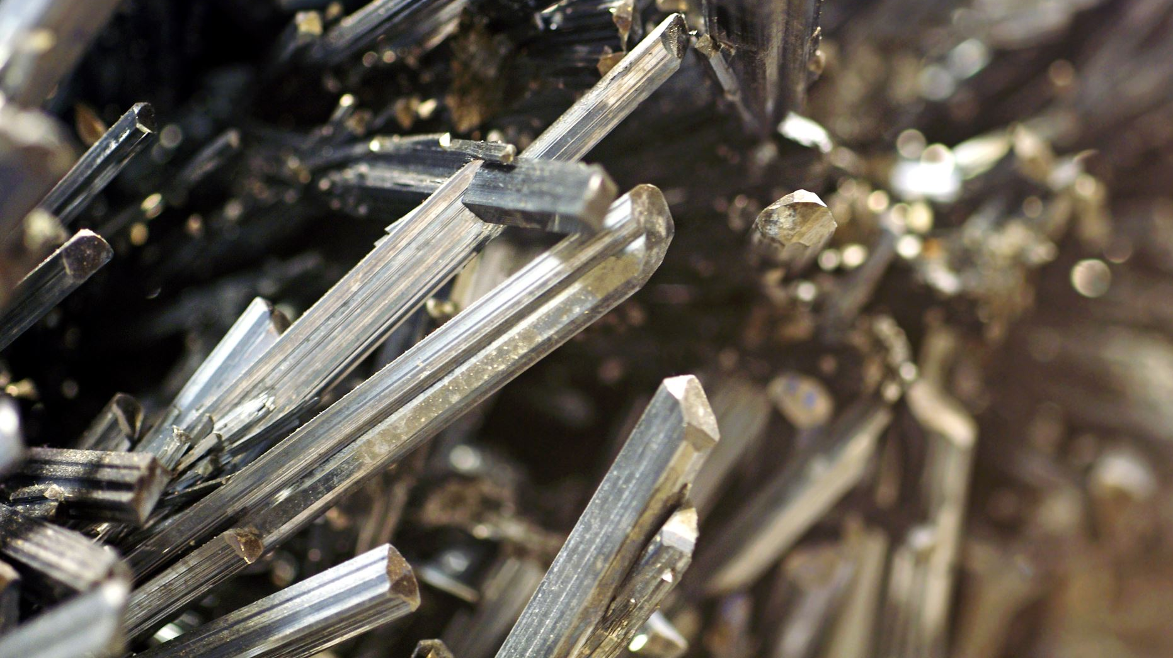
DETOXIFICATION OF HEAVY METALS
A heavy metal detox aims to remove excess heavy metals from the body.
A substance that binds to heavy metals is known as a chelator, and the process that transports them out of the body is called chelation.
Some examples of heavy metals that cause negative health effects:
Lead
Mercury
Aluminum
Arsenic
Nickel
Cadmium
Chromium

Slide 8
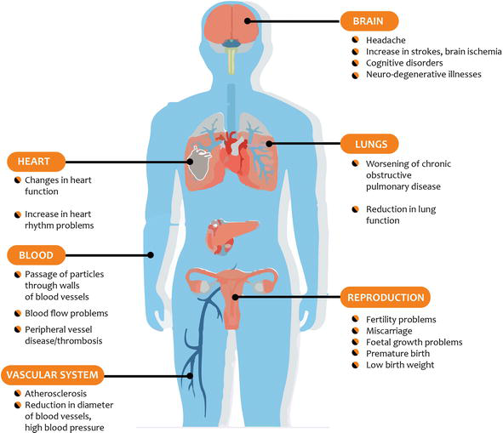
HEAVY METAL EFFECTS ON HUMAN HEALTH
Several acute and chronic toxic effects different body organs. Heavy metal toxicity symptoms may include gastrointestinal issues, fatigue, brain fog, anxiety, , mood changes or depression, or joint pain. Toxicity may cause an overall systematic damage that may lead to:
Gastrointestinal & Kidney dysfunction
Nervous System Disorders
Skin Lesions
Vascular Damage
Immune System Dysfunction
Birth Defects
Cancer
International Science and Nutrition Society – CURARE CAUSAM – ISNS 2021

Slide 9
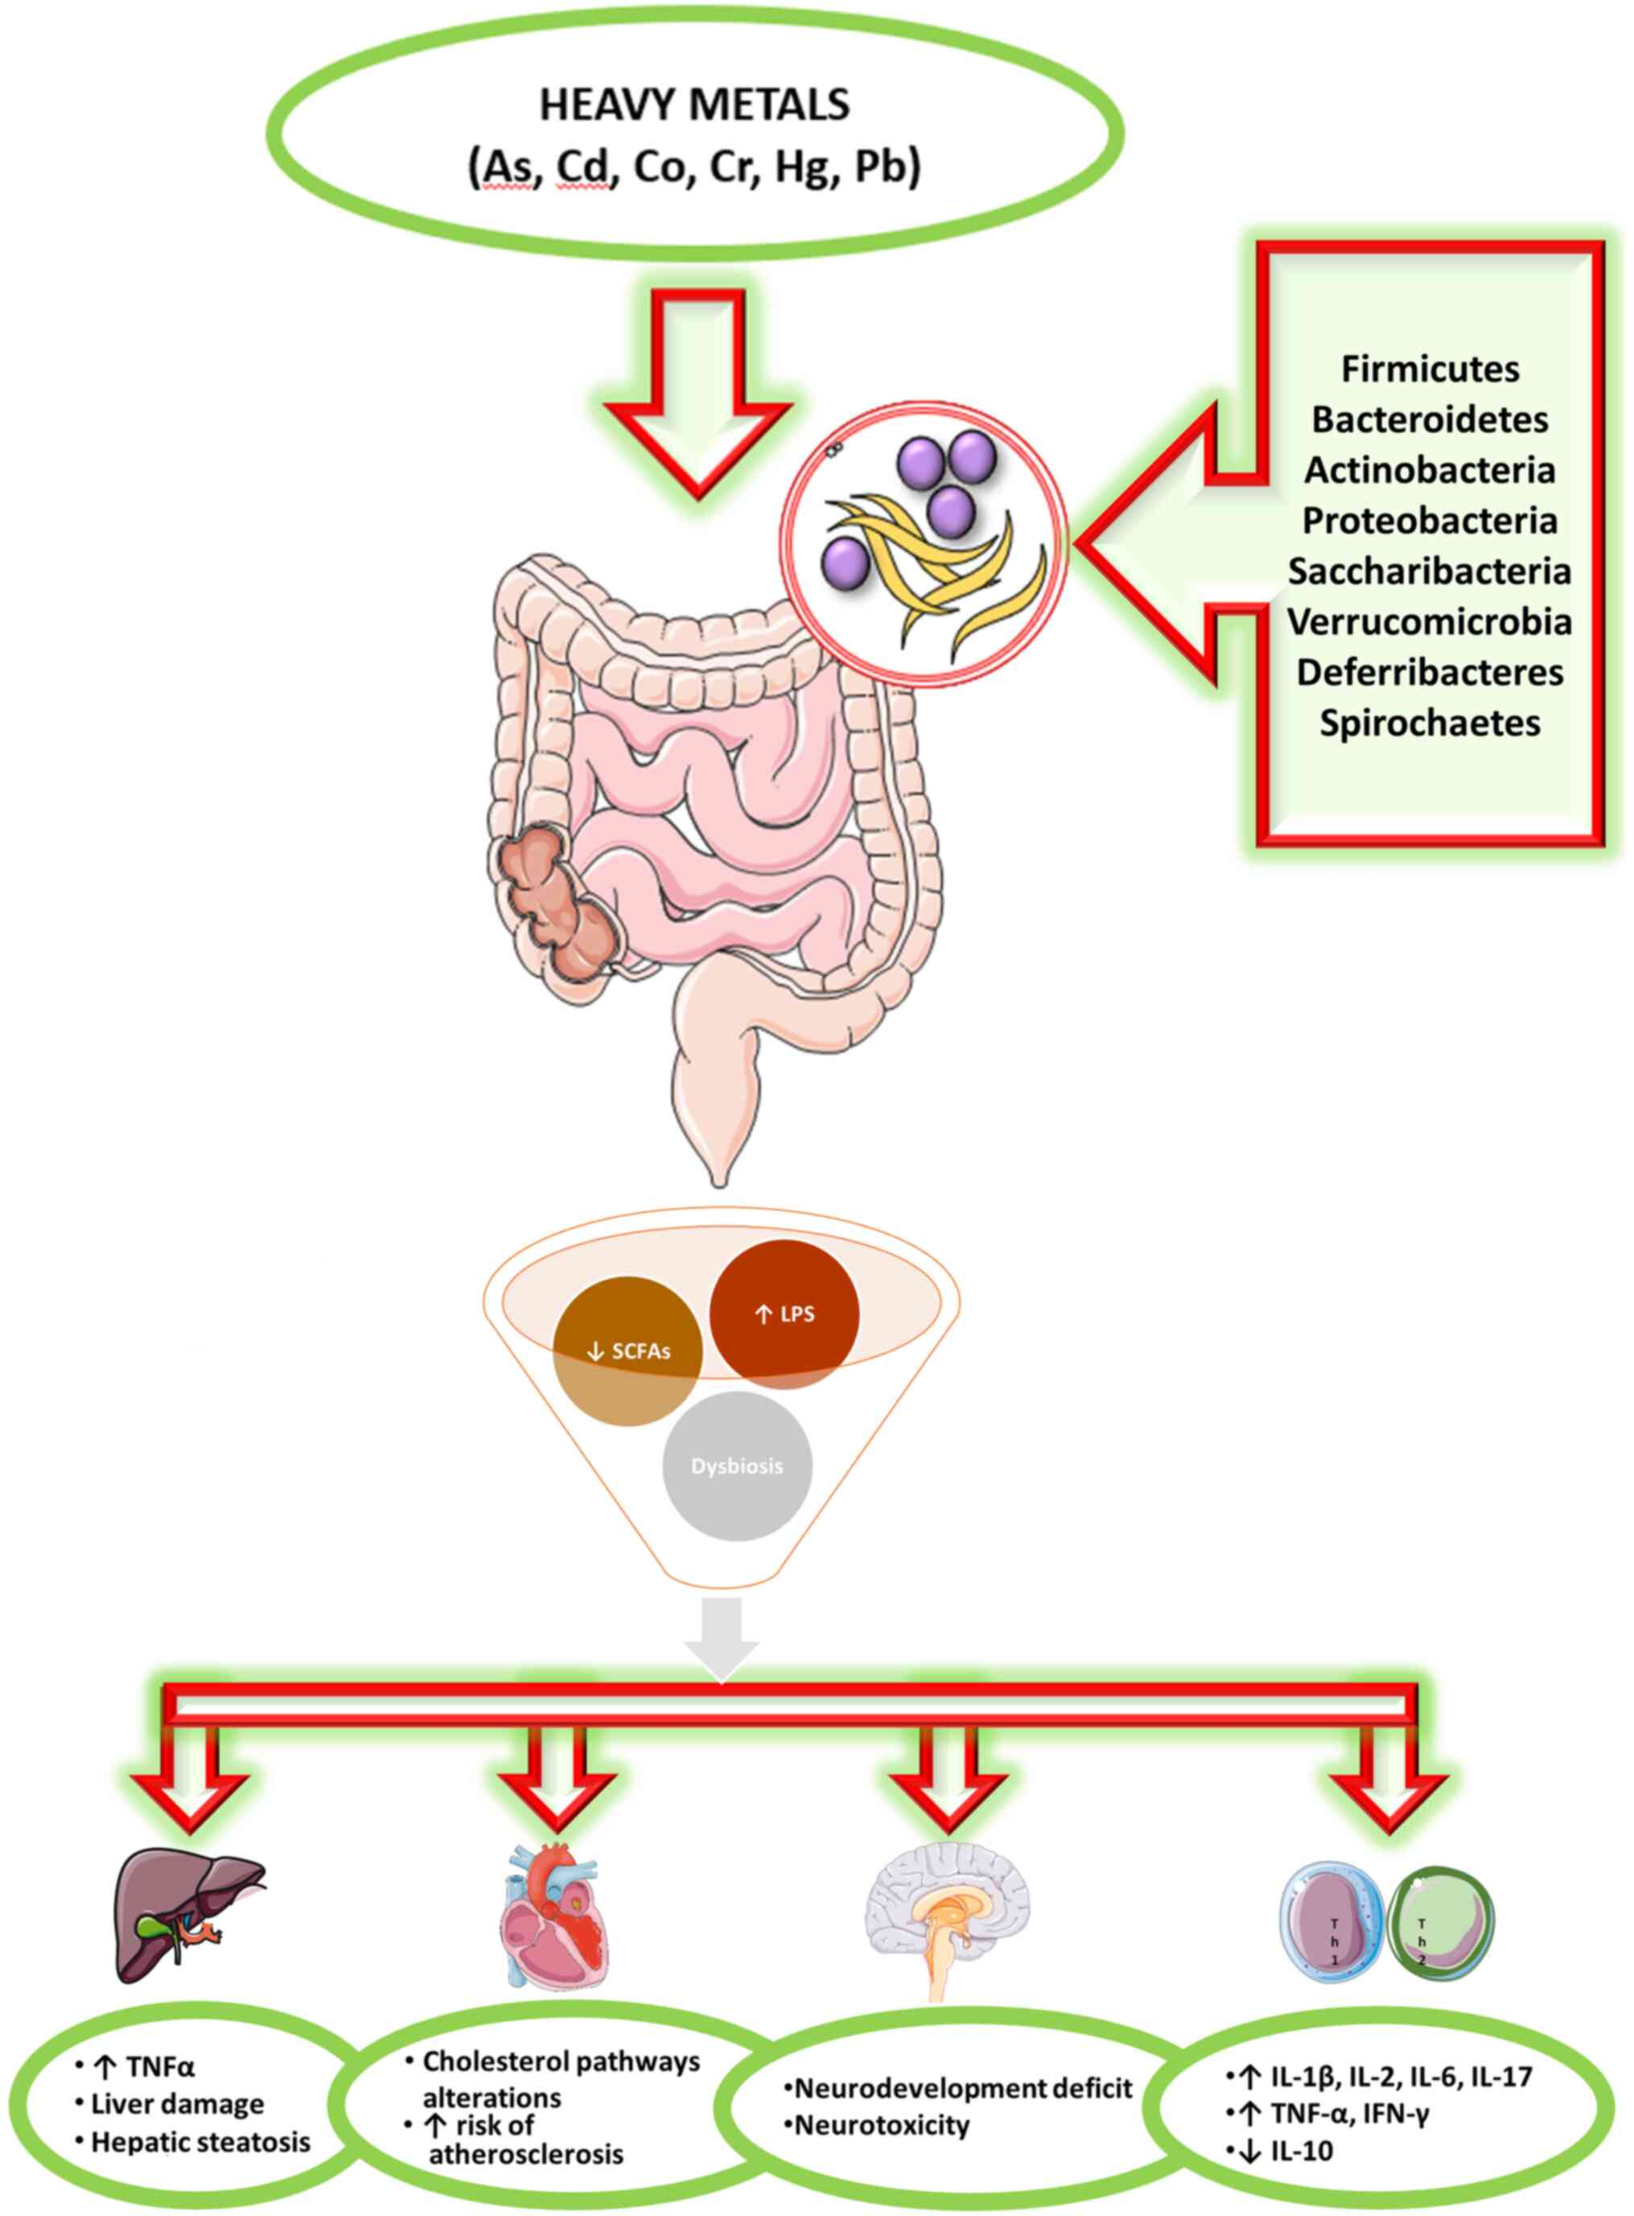
GUT MICROBIOME & HEAVY METAL ABSORPTION

Slide 10
PROPRIETARY BLENDS LEGEND
LEGEND
Proprietary blend I: silica, vitamin c, and trace minerals.
Proprietary blend II: N-acetyl L-tyrosine, anhydrous caffeine, L-theanine, velvet bean seed, pine bark, curcumin, and vitamin D
Proprietary blend III: black seed oil, resveratrol, turmeric, raspberry ketone, apple cider vinegar, aloe Vera, and d-ribose
Proprietary blend IV: Vitamin C, zinc sulfate, and vitamin D3
Proprietary blend V: Inulin, Green Banana flour, apple fiber, bacillus coagulans, spirulina, wheat grass, barley grass, alfalfa leaf, flax seed, psyllium husk powder, chlorella, broccoli, kale, spinach, green cabbage, parsley, aloe vera, cayenne pepper, blueberry powder, pomegranate seed powder, and MCT coconut oil powder
International Science and Nutrition Society – CURARE CAUSAM – ISNS 2021

Slide 11
CASE STUDY: PROPRIETARY BLENDS
PROPRIETARY BLEND I
PROPRIETARY BLEND V
Proprietary blend I uses silica, nature’s best detoxifying mineral, vitamin C, and over 75+ trace minerals to help wipe your cells clean of the toxins and heavy metals trying to take them over.
Proprietary Blend V is a powerful combination of natural vegetables, fruits, prebiotics, and probiotics, working in synergy to remove the body of unwanted toxins to support a healthy immune system.
International Science and Nutrition Society – CURARE CAUSAM – ISNS 2021

Slide 12
ISNS CASE STUDY 1:
Patient: Male
Age: 49-year-old
Symptoms: At our first consultation, he had weakness, headache, cough, respiratory irritation
Higher than normal levels of cadmium and mercury

Slide 13
ISNS CASE STUDY 2:
Patient: Female
Age: 38-year-old
Symptoms: At our first consultation, she had weakness, headache, dry skin, severe hair loss, hormonal problems, memory impairment, concentration problems
Higher than normal levels of arsenic and lead

Slide 14
ISNS CASE STUDY 3:
Patient: Female
Age: 66-year-old
Symptoms: At our first consultation, she had weakness, headache, dry skin, severe hair loss, memory impairment, concentration problems, tremor, hearing loss
Higher than normal levels of arsenic and mercury

Slide 15
ISNS CASE STUDY 2:
Patient: Male
Age: 31-year-old
Symptoms: At our first consultation, he had weakness, headache, concentration problems, higher blood pressure, digestive problems
Higher than normal levels of mercury and lead

Slide 16
ISNS CASE STUDY 4:
Patient: Male
Age: 56-year-old
Symptoms: At our first consultation, he had weakness, headache, dry skin, hair loss, memory impairment, concentration problems
Higher than normal levels of arsenic, lead and cadmium

Slide 17
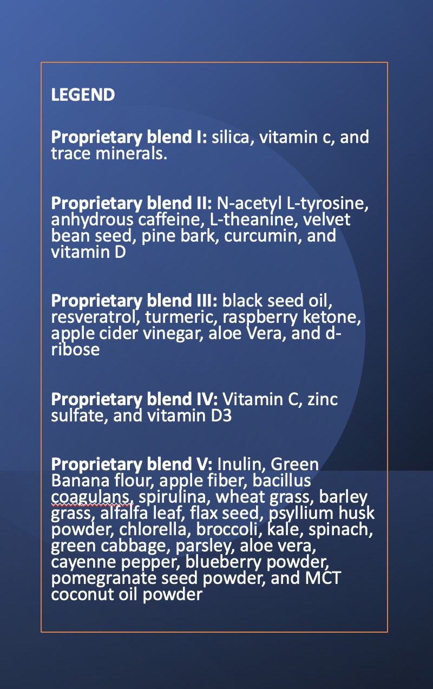
THERAPY
Proprietary blend I : 2x5 drops, morning and evening, for 3 days, then every 3 days then increased by 1-1 drops every 3 days to 2x10
Proprietary blend V : 1 teaspoon in the evening for 14 days, then 2 teaspoon in the morning and in the evening
International Science and Nutrition Society – CURARE CAUSAM – ISNS 2022

Slide 18
RESULTS
after 1 month all the symptoms started decreasing in all patient's case
1
by the end of the 3rd month, significant improvement appeared, nearly all symptoms were gone. The control laboratory tests have shown normalized results!
3
by the end of the 2nd month, further improve-ment was experienced
2

Slide 19
Gut microbiota: A target for heavy metal toxicity and a probiotic protective strategy Hui Duan, Leilei Yu, Fengwei Tian, Qixiao Zhai, Liuping Fan, and Wei Chen
The gut microbiota are the first line of defense against the toxic effects of heavy metals. Heavy metal exposure alters the composition and metabolic profile of the gut microbiota at the functional level. Moreover, the gut microbiota can affect the integrity of the intestinal barrier, which may also in turn affect the absorption of heavy metals.
Probiotics have been shown to reduce the absorption of heavy metals in the intestinal tract via the enhancement of intestinal heavy metal sequestration, detoxification of heavy metals in the gut, changing the expression of metal transporter proteins, and maintaining the gut barrier function
https://pubmed.ncbi.nlm.nih.gov/32629250/

Slide 20
Vitamin C modulates lead excretion in rats Hoseob Lihm, Hyun Kim, Heekyung Chang, Myunghee Yoon, Kayoung Lee, and Jongsoon Choi
Lead, one of the most toxic heavy metals, takes longer time to be excreted from the body than other heavy metals. In this study, researchers measured lead excretion vita urine and feces to find out the effect of vitamin C in lead chelation.
Out of 36 mice, 29 survived: 76.9% survived in the lead only administered group; 90.9% survived in the lead administration and low dose of vitamin C; and 100% survived in the lead administration and high dose of vitamin C group
Low vitamin C intake group exhibited higher urinary excretion than the lead only group. The urinary excretion level in high dose vitamin C intake group was significantly higher than the lead only group. Overall, it was found that administrating high dose of vitamin C accelerated the excretion of lead in body compared to low dose of vitamin C.
In addition, fecal lead excretion seemed to be increased in the high dose vitamin C intake group, compared to the group with lead administrations
https://www.ncbi.nlm.nih.gov/pmc/articles/PMC3875841/

Slide 21
Functionalized Nanoporous Silica for the Removal of Heavy Metals from Biological Systems: Adsorption and Application Wassana Yantasee, Ryan D. Rutledge, Wilaiwan Chouyyok, Vichaya Sukwarotwat, Galya Orr, Cynthia L. Warner, Marvin G. Warner, Glen E. Fryxell, Robert J. Wiacek, Charles Timchalk, and R. Shane Addleman
In this study, researchers developed a thiol-modified nano-porous silica material (SH-SAMMS) as an oral therapy for the prevention and treatment of heavy metal poisoning.
The results found that SH-SAMMAS effectively removed inorganic mercury from biologically digested fish tissue; it could hold inorganic mercury and methyl mercury inside nano-size pores, which in turn prevents bacteria from converting them to more absorbable forms
In rats fed a diet containing methyl mercury, cadmium, and lead, and silica had blood inorganic levels significantly lower than the rats fed the metal diet exclusively
The rats fed silica suffered from less metal exposure induced weight loss
https://www.ncbi.nlm.nih.gov/labs/pmc/articles/PMC3429124/

Slide 22
Dietary Strategies for the Treatment of Cadmium and Lead Toxicity Qixiao Zhai, Arjan Narbad, and Wei Chen
Many studies in both animals and humans have shown that a deficiency in essential metals such as zinc, calcium, or iron can lead to greater absorption and toxicity of Cadmium and lead.
Intake of zinc induces the synthesis of metallothionein, a low molecular weight protein that has a high affinity for Cd and causes detoxification by binding Cd. Zinc intake has been reported to alleviate oxidative stress caused by Cd and Pb exposure.
Selenium is a cofactor of the antioxidant enzyme glutathione peroxidase (GPx) and it contributes to the antioxidant defense system, which enables it to alleviate Cd and Pb toxicity by reducing the Cd/Pb-induced oxidative stress and enhancing the antioxidant capacity of the host.
Iron supplement can prevent or limit Cd absorption by reducing the expression of such transporters. To explain the decrease in intestinal Cd absorption after iron supplementation, iron competes with Cd for entry to the intestinal metal uptake transporters including divalent metal transporter-1 (DMT1) and metal transporter protein 1 (MTP1).
https://www.ncbi.nlm.nih.gov/pmc/articles/PMC4303853/

Slide 23
REFERENCES
https://www.healthline.com/health/heavy-metal-poisoning
https://www.frontiersin.org/articles/10.3389/fphar.2021.643972/full
https://www.ncbi.nlm.nih.gov/pmc/articles/PMC4427717/
https://pubmed.ncbi.nlm.nih.gov/32629250/
https://www.ncbi.nlm.nih.gov/pmc/articles/PMC3875841/
https://www.ncbi.nlm.nih.gov/labs/pmc/articles/PMC3429124/
https://www.ncbi.nlm.nih.gov/pmc/articles/PMC4303853/

Slide 24
THANKS FOR JOINING US TODAY!

